Slide 1

Consuming a REST Service
Reynaldo Monares
Sr. Mobile App Developer at Pangga Mobile Technologies

Slide 2
What is REST?
REST stands for Representational State Transfer.
Representational State Transfer (REST) is an architectural style for building web services.
REST requests are made over HTTP using the same HTTP verbs that web browsers use to retrieve web pages and to send data to servers.

Slide 3
HTTP Verbs
GET – this operation is used to retrieve data from the web service.
POST – this operation is used to create a new item of data on the web service.
PUT – this operation is used to update an item of data on the web service.
PATCH – this operation is used to update an item of data on the web service by describing a set of instructions about how the item should be modified. This verb is not used in the sample application.
DELETE – this operation is used to delete an item of data on the web service.

Slide 4
What is REST?
Web service APIs that adhere to REST are called RESTful APIs, and are defined using:
A base URI.
HTTP methods, such as GET, POST, PUT, PATCH, or DELETE.
A media type for the data, such as JavaScript Object Notation (JSON).

Slide 5
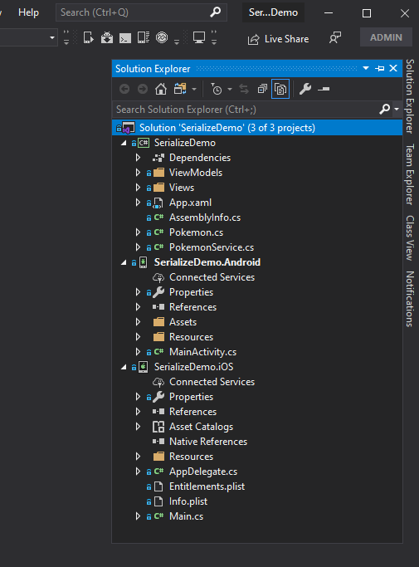
Solution Setup
Create a new Xamarin.Forms Project named SerializeDemo.
Add a Views and ViewModels directory in the shared project.
Drag the default xaml file MainPage.xaml into the Views directory.
Inside the ViewModels directory, add a new class for the view model named MainPageViewModel.cs.
Add another class named PokemonService.cs.

Slide 6
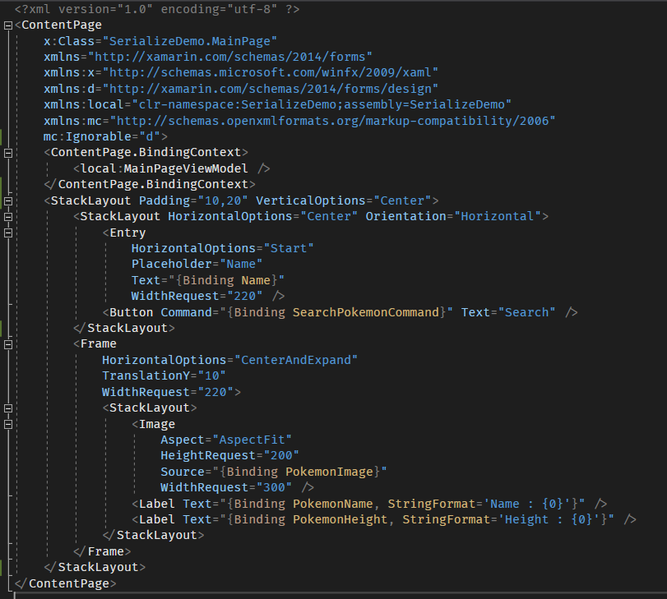
MainPage.xaml

Slide 7
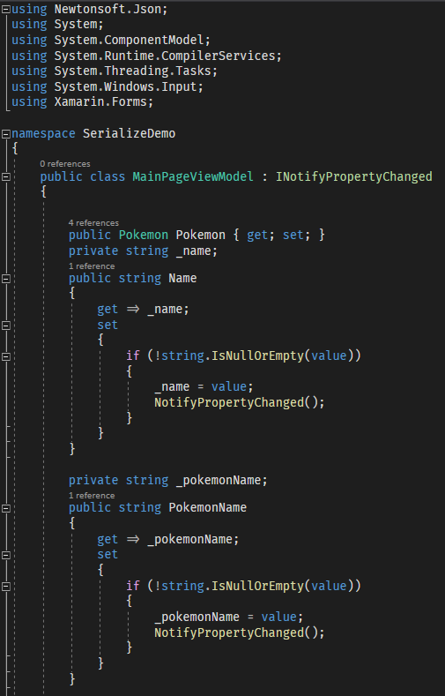
MainPageViewModel.cs
NOTE: Do not forget to install Newtonsoft.Json which is needed in Serialize/Deserialize Json.

Slide 8
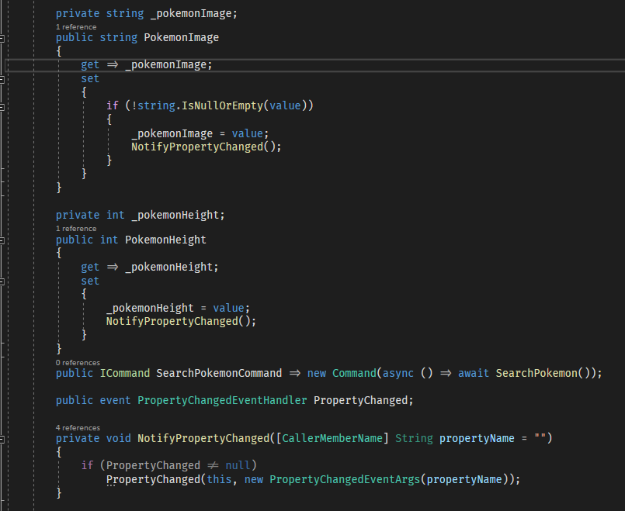
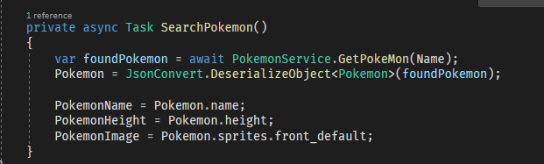
MainPageViewModel.cs

Slide 9
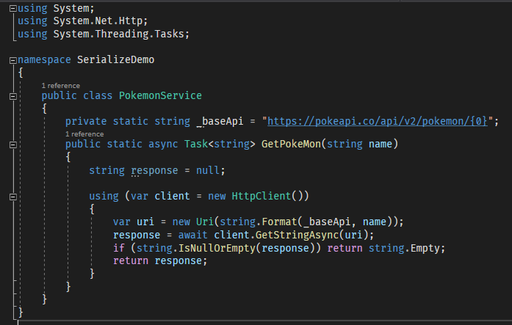
PokemonService.cs

Slide 10
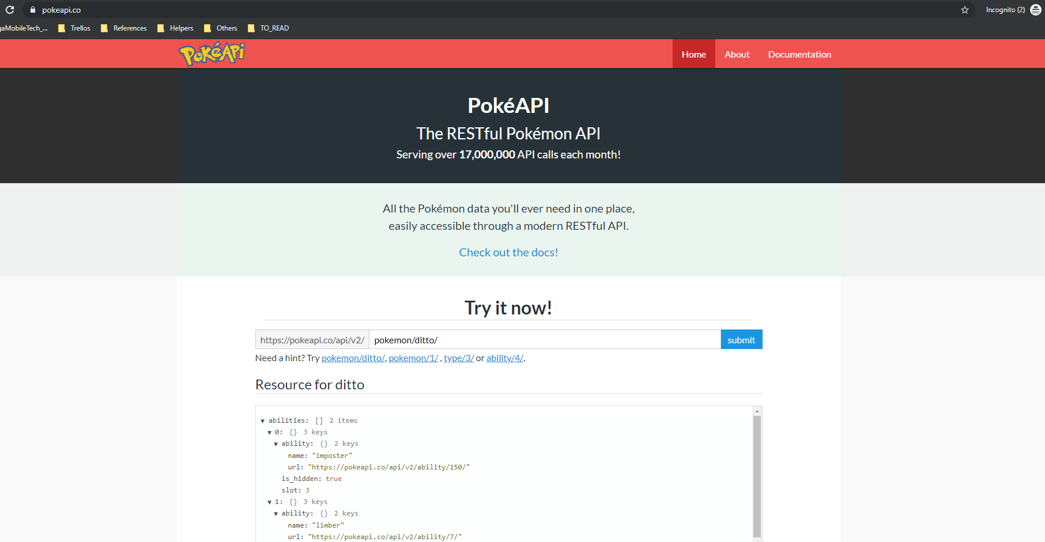
PokeAPI

Slide 11
Pokemon.cs
Navigate to https://pokeapi.co/.
From there, you will see a sample JSON result.
Copy the whole JSON result.
Navigate to http://json2csharp.com/ to convert the JSON into C# classes to be used as our Model.
Create a class in the shared project and name it as Pokemon.cs.
Copy the generated class from website to this newly added class.
In the file, look for RootObject class and rename it with Pokemon

Slide 12
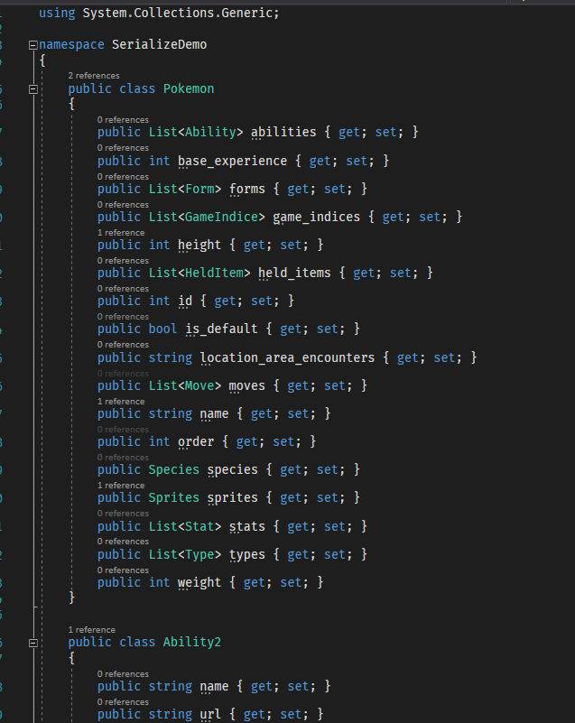
Pokemon.cs
The image at the right shows part of the generated C# classes

Slide 13
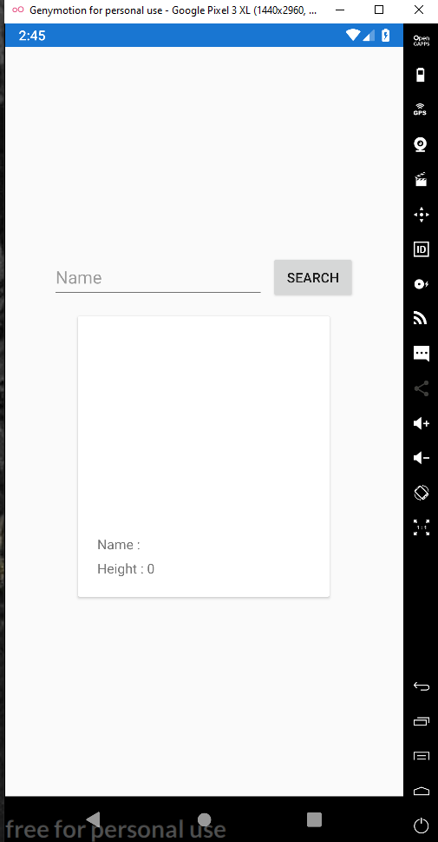
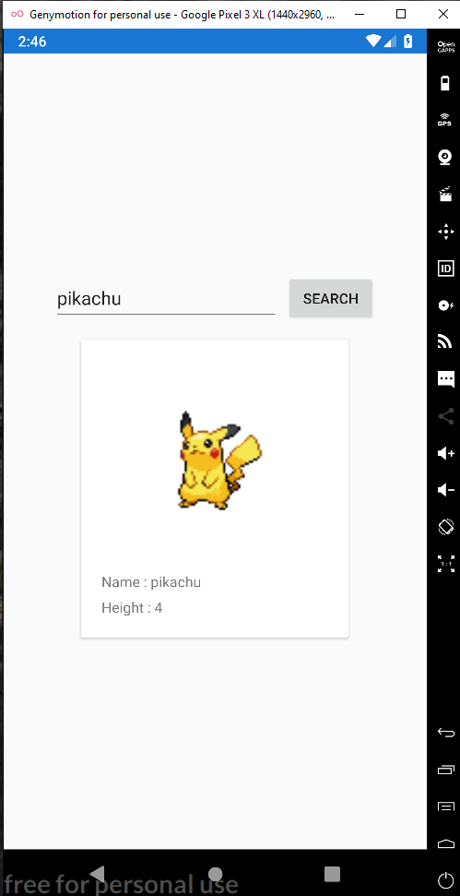
Final Output

Slide 14
DEMO

Slide 15

Questions?

